Slide 1
• In Year 1748, Benjamin Franklin coined the term "Battery".
• In year 1792, Alessandro Volta is remarked for his work on Electro Chemical Cell.
• In year 1836, John Daniell worked on Cu-Zn-H2S04 voltaic cell
• In Year 1959, Gaston Plante lead acid rechargeable battery.
• In 1886, Carl Cassner, invented zin carbon dry cell.;
• In 1899, Waldemar Junger worked on NiCd rechargeable battery
• In 1950, Lewis Urry alkaline battery
• In 1985, Concorde, absorbed glass mat (ACM) battery.

Slide 2
TYPES OF BATTERIES
• Lead Acid
> Flooded Lead Acid
> ACM Sealed Lead Acid
> Gel Sealed Lead Acid
• Nickel Cadmium
• Lithium Batteries
> Lithium ion
> Lithium Polymer
> Lithium Ion Manganese oxide
• Nickel Metal Hydride

Slide 3

LEAD ACID BATTERY
Pb + Pb02 + 2H2S04 2PbS04 + 2H20

Slide 4
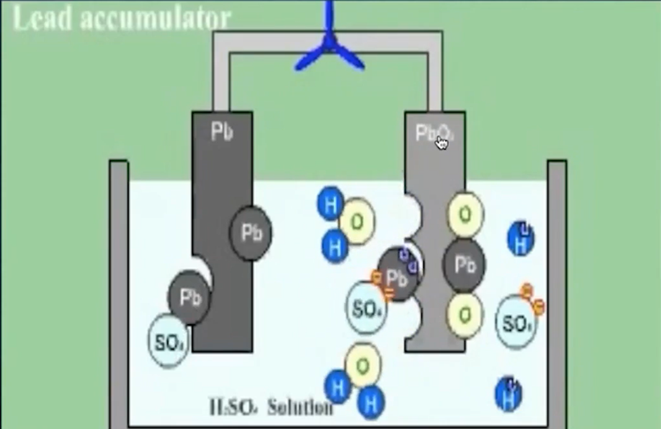
Lead acid battery
Pb + Pb02 + 2H2S04 2PbS04 + 2H20

Slide 5
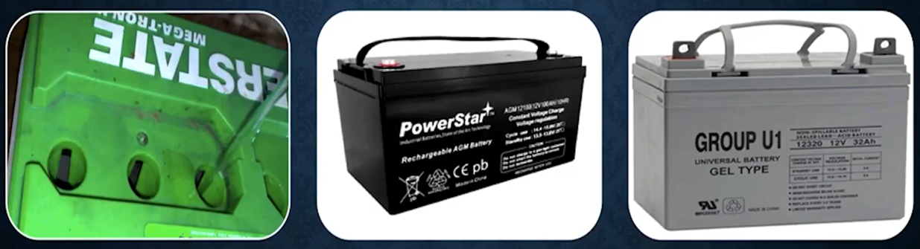
Types or lead acid batteries
Flooded Lead
Acid Batteries
ACM Sealed
Lead Acid Battery
Gel Sealed Lead
Acid Types

Slide 6
Lead acid battery chemistry
• In the charged state
Cathode(+electrodes ) are elemental lead Pb. Anodes(- electrodes) are lead
oxide (Pb02) Electrolyte is dilute sulphuric acid (-33.5% H2S04)
• In discharged state:-
Both electrodes become lead sulphate (PbS04)
Electrolyte primarily water (H20)

Slide 7
Flooded cell vs AGM & GEL
• The main difference between VRLA
or Sealed Lead Acid batteries and
Flooded lead batteries is that the
electrolyte in the VRLA batteries is
immobilized. This can be achieved
by using Absorbed Glass Mat
separators or Celled electrolyte
which divides VRLA batteries into
two subtypes - ACM and GEL.
• Advantages of VRLA / AGM
• Higher Energy Density (upto 1.5x)
• Lower Internal Resistance allows faster
charge and discharge rates.
• Lower self-discharge rate
• More resistance to freezing
• More tolerant to vibration
• Maintenance - free

Slide 8
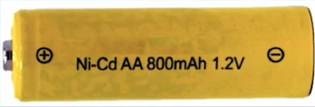
Nickel Cadmium
• The nickel cadmium battery was considered to be one of the main competitors to the lead acid battery for use in electric vehicles and these batteries have nearly twice the specific energy of lead acid batteries.
• On the negative side, the operating voltage of each cell is only about 1.2 V, so 10 cells are needed in each nominally 12 V battery, compared to 6 cells for lead acid. This partly explains the higher cost of this type of battery.

Slide 9
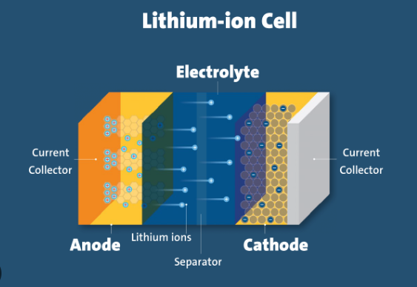
Lithium ION
Pb + Pb02 + 2H2S04 2PbS04 + 2H20

Slide 10

Lithium Polymer
• The lithium polymer battery uses lithium metal for the negative electrode and a transition metal intercalation oxide for the positive. In the resulting chemical reaction the lithium combines with the metal oxide to form a lithium metal oxide and release energy.
• When the battery is recharged the chemical reaction is reversed.
• The lithium is thus both a reactant and the mobile ion that moves through the electrolyte. The overall chemical reaction is:

Slide 11
Lithium Ion Manganese Oxide Battery
• A Lithium ion manganese oxide battery is a lithium ion cell that uses manganese dioxide, MnO
2, as the primary cathode material. They function through the
same intercalation/de-intercalation mechanism as other
commercialized secondary_ battery technologies, such as LiCoO
2, They are a promising technology as their manganese-oxide components are earth-abundant, inexpensive, non-toxic, and provide better thermal stability.

Slide 12
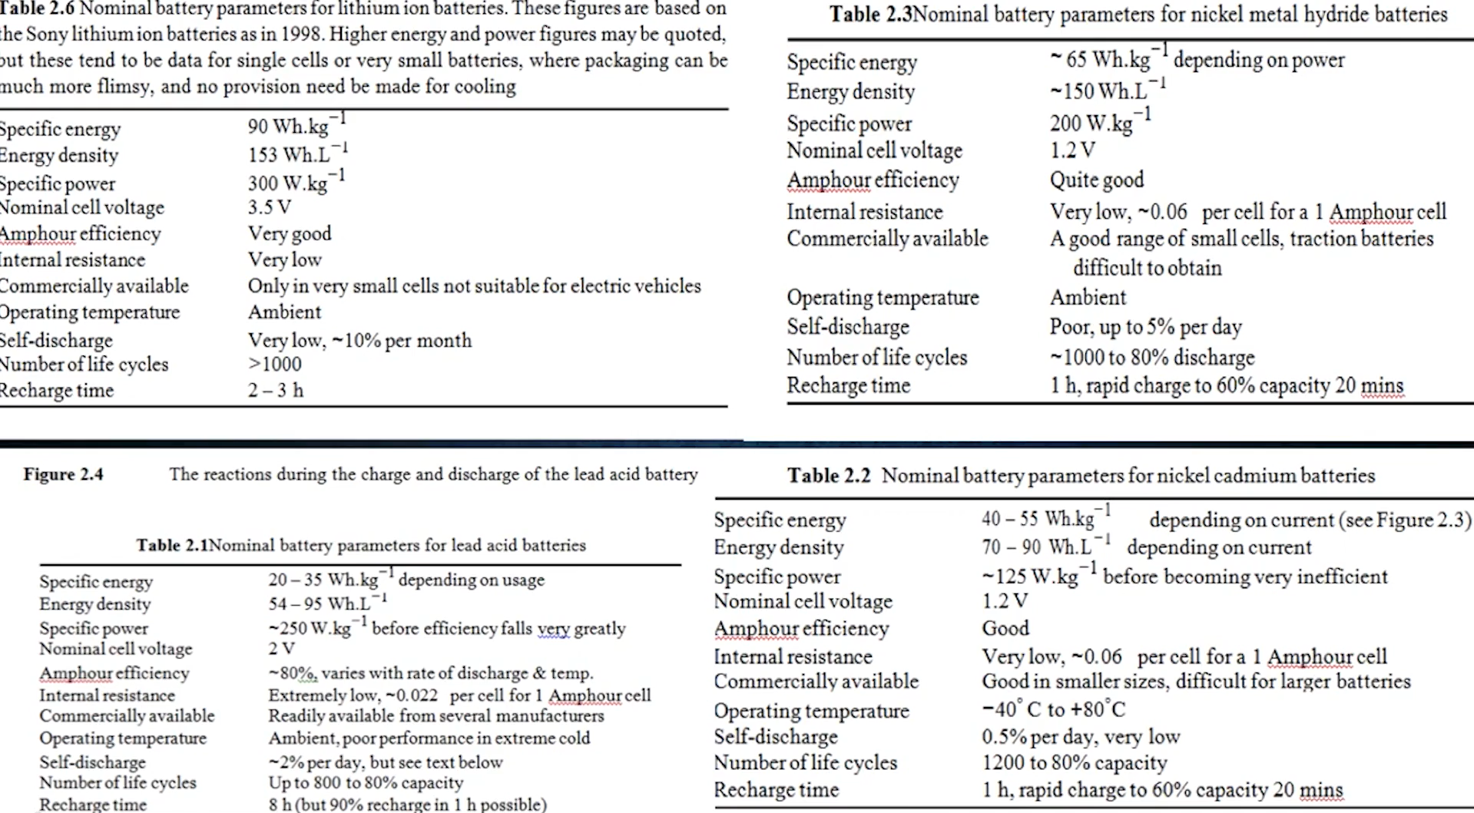

Slide 13
Welcome To Diy Guru TYPES OF BATTERIES

